Slide 1
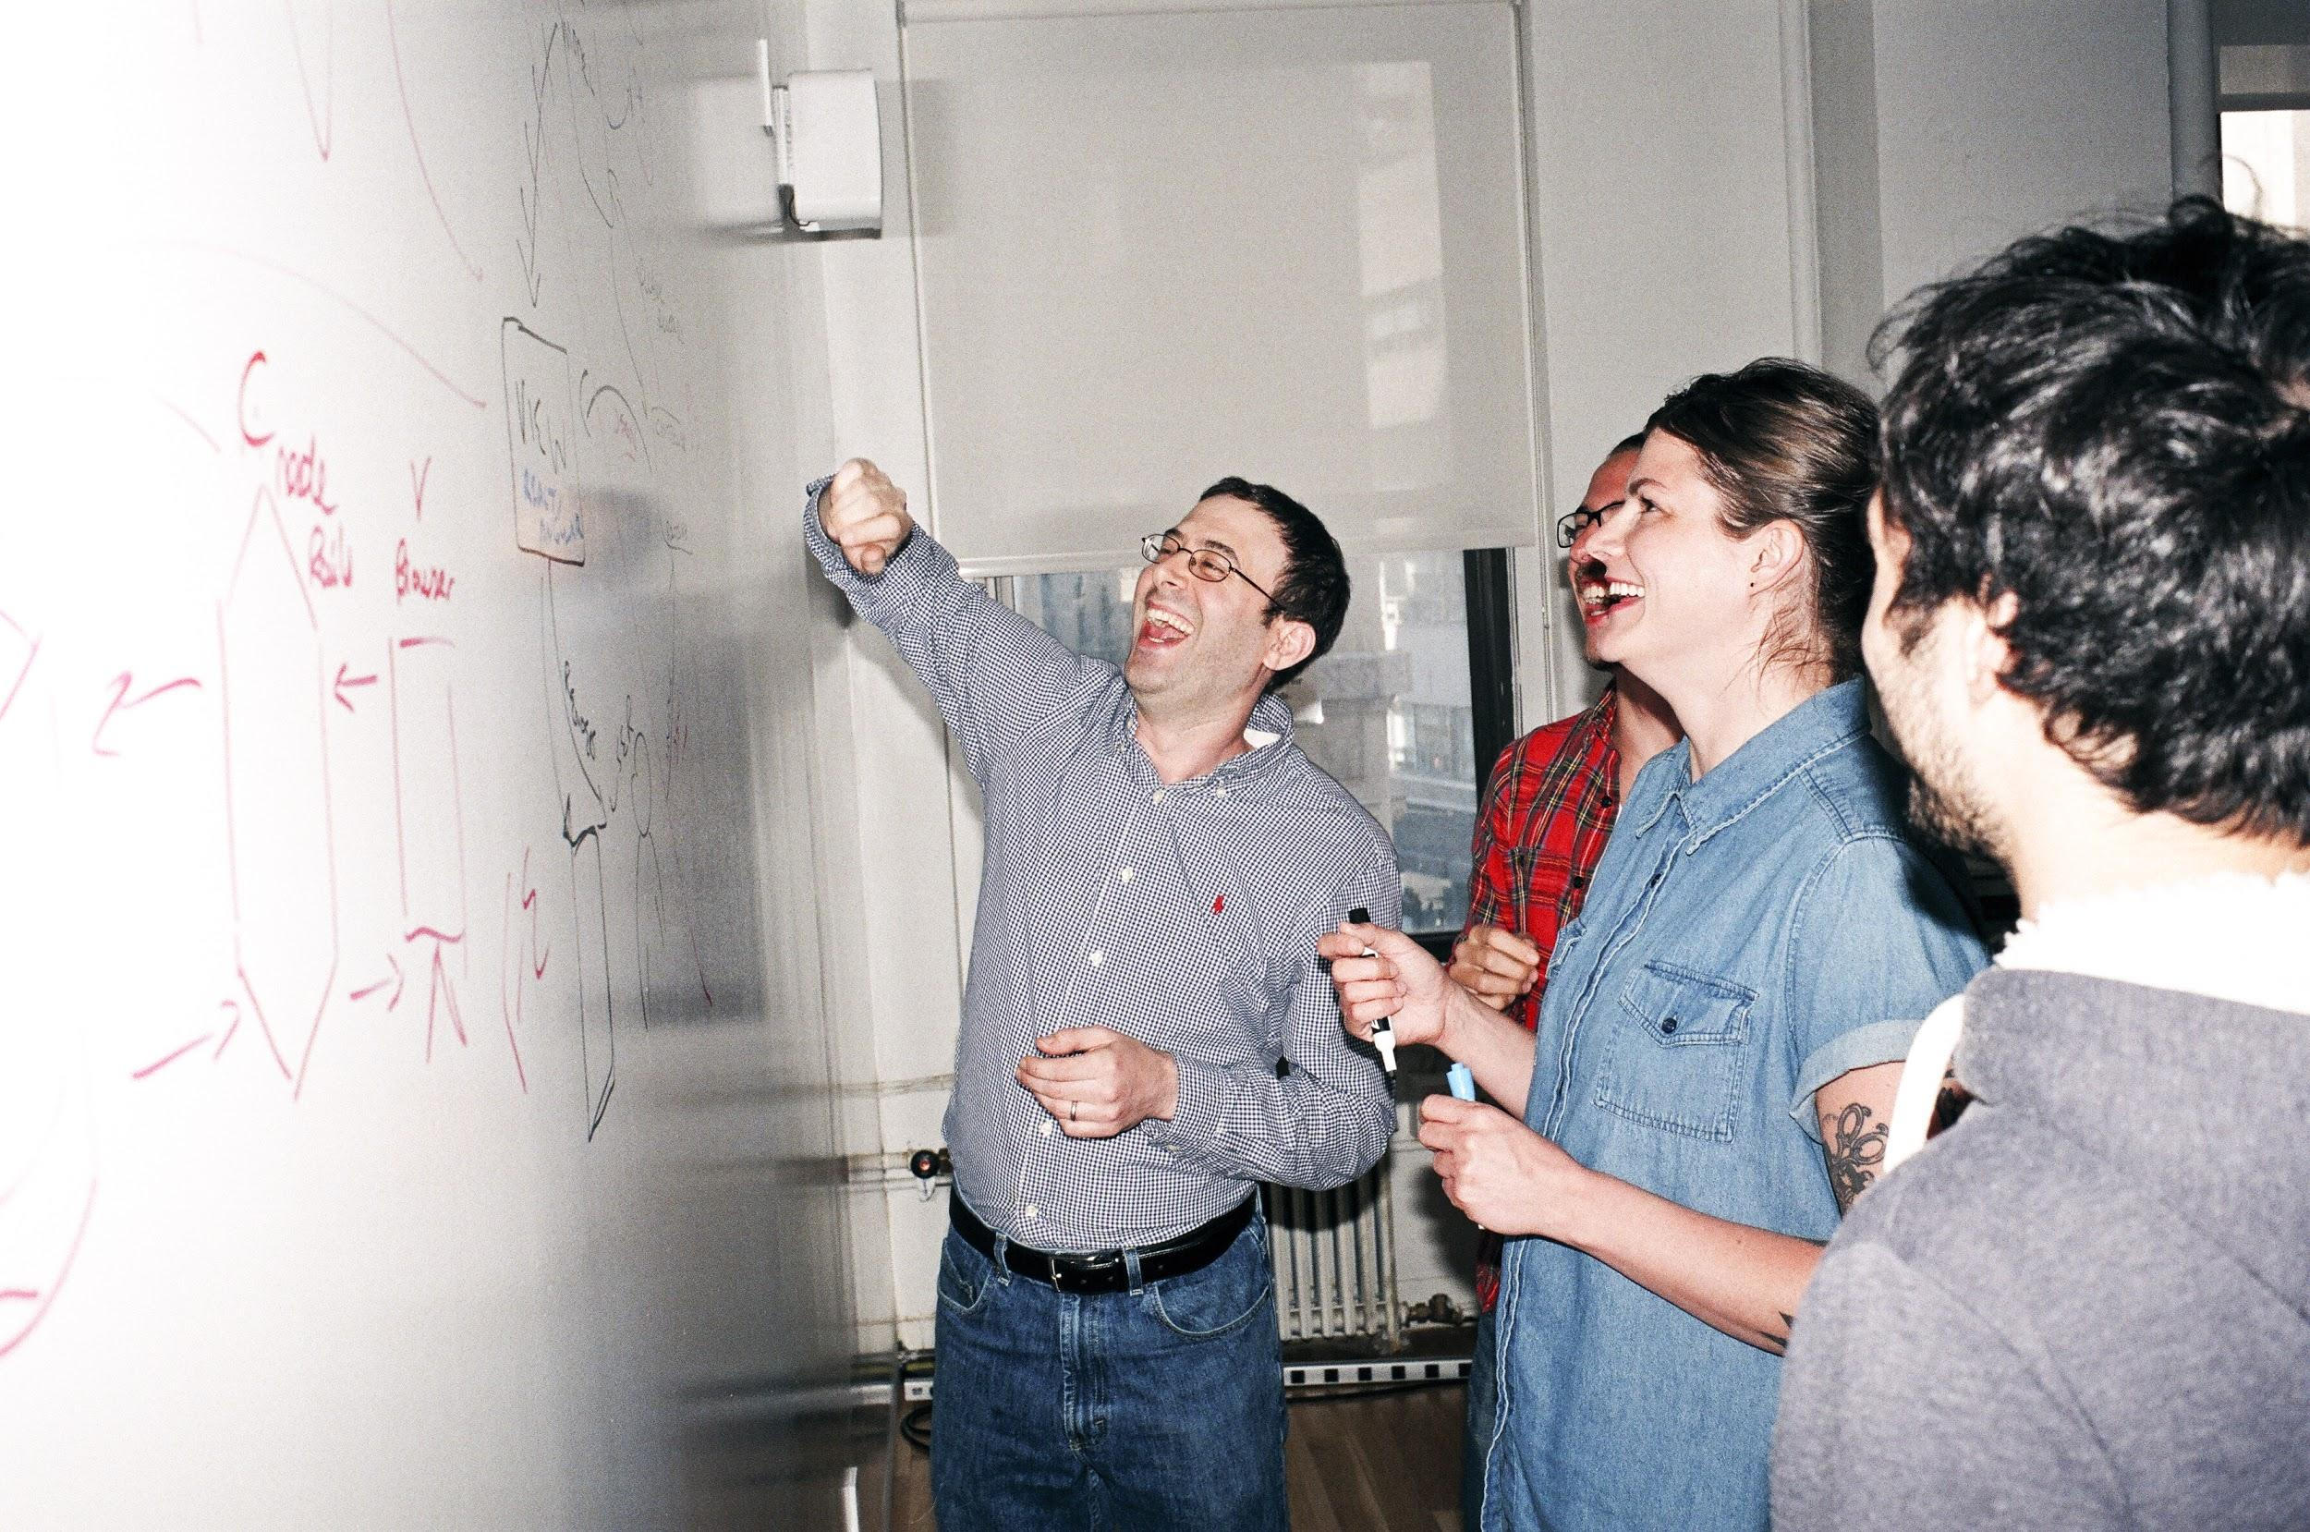

Welcome to General Assembly
WiFi GA Guest
Password yellowpencil
Notes:
[Leave this slide visible until presentation starts]

Slide 2
DATA SCIENCE
10 WEEK PART TIME COURSE
Lesson-07: Regularisation

Slide 3
Course Plan
Paul & James review final project ideas

Slide 4
Git & GitHub – 1 Pager Guide!

Slide 5
AGENDA
Motivation / Review
What is Regularisation?
Why use Regularisation
Lab
Discussion

Slide 6
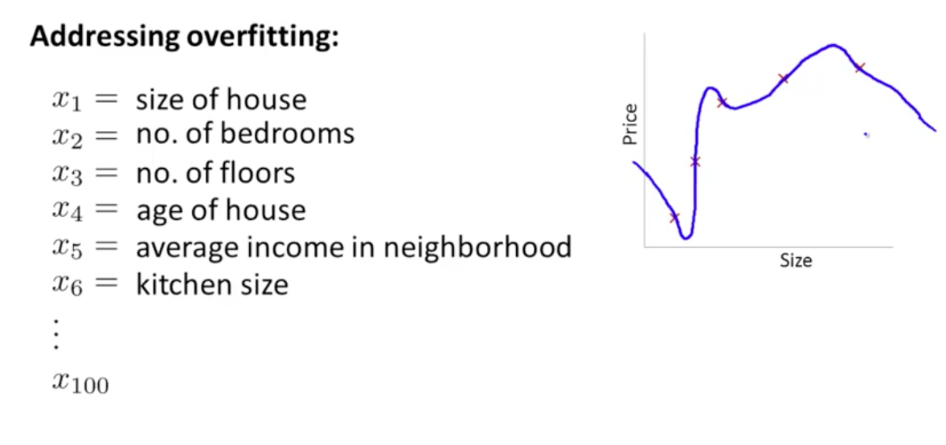
Example of overfitting

Slide 7
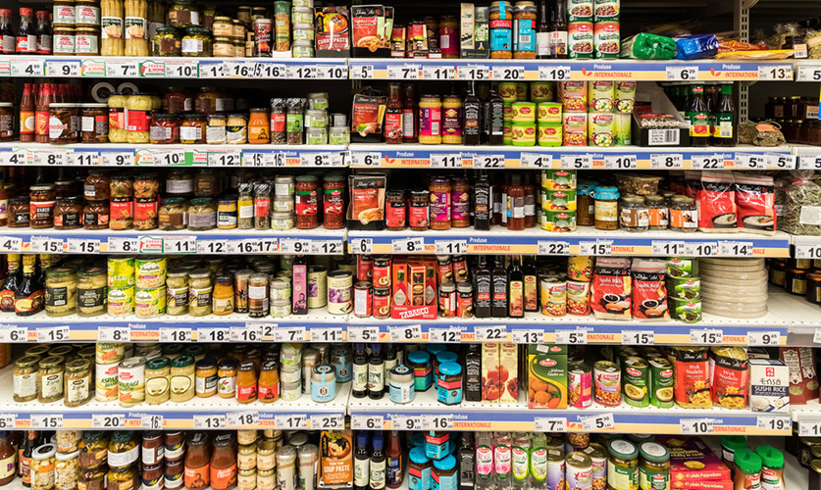
AGENDA
GUEST SPEAKER - Rainer Hillermann !
Motivation / Review
What is Regularisation?
Why use Regularisation
Lab
Discussion
Too many variables

Slide 8
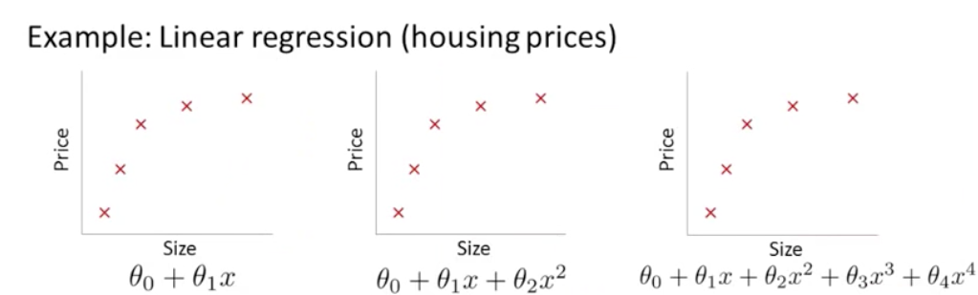
How complex should the model be?

Slide 9
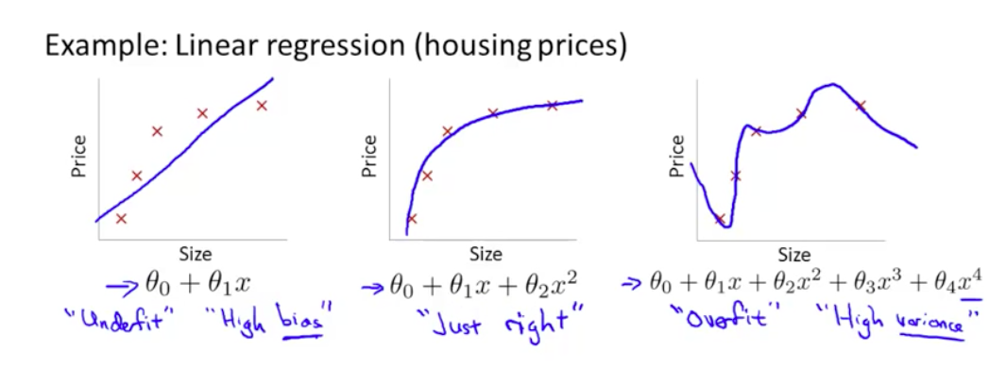
How complex should the model be?

Slide 10
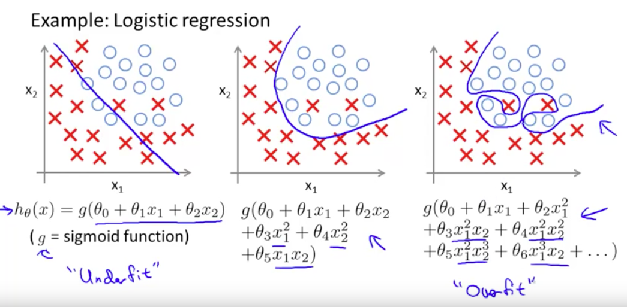
How complex should the model be?
Example: Classification

Slide 11
How do we choose the right balance between complexity and accuracy, to prevent under-fitting or over-fitting?

Slide 12
How do we choose the right balance between complexity and accuracy, to prevent under-fitting or over-fitting?
Solution:
REGULARISATION

Slide 13
Problem Space: Accuracy .vs. Complexity
We already have ways to measure model accuracy (R² etc…)
We should quantify what we mean by complexity…

Slide 14
Problem Space: Accuracy .vs. Complexity
We already have ways to measure model accuracy (R² etc…)
We should quantify what we mean by complexity…
Qn: Can you order these models from simplest to most complex?
Qn: What criteria did you use?
(Answer: 1, 2, 3=4, 5)

Slide 15
Problem Space: Accuracy .vs. Complexity
It’s agreed that intuitively, “complexity” is about the number of features in the model (regardless whether they are different features or multiple transformations of the same feature!)
Mathematically this is true as well.
There are 2 well-known methods of doing this:
Lasso Regularisation (“Lasso Regression”)
Ridge Regularisation (“Ridge Regression”)

Slide 16
Model Coefficients: Discussion
What do the coefficients (b) in the model actually tell you?
What if coefficient β₁ is +ve and large?
What if a coefficient β₁ is –ve and large?
What if coefficient β₁ is +ve and small?
What if coefficients β₃ and β₄ are equal and opposite sign?
What if coefficients β₃ and β₄ are close to zero? (…or actually zero?...)

Slide 17
HOW DOES Regularisation WORK?
A tuning parameter lambda λ (or sometimes alpha α) imposes a penalty on the size of coefficients.
Instead of minimizing the "loss function" (mean squared error), it minimizes the "loss plus penalty".
A tiny alpha imposes no penalty on the coefficient size, and is equivalent to a normal linear model.
Increasing the lambda λ penalizes the coefficients and shrinks them toward zero.

Slide 18
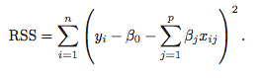
Regularisation
Recall from Week 2 that the least squares procedure estimates coefficients that minimise
Regularisation (or Shrinkage) is a way to constrain the estimates of beta to be close or equal to zero.

Slide 19
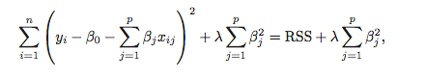
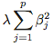
RIDGE REGRESSION
Ridge Regression is similar to least squares, except we include a penalty term,
the λ term is a tuning parameter. When it is zero we get least squares,
as it increases the term, (the shrinkage penalty) has more of an
impact and the coefficients will approach zero.

Slide 20
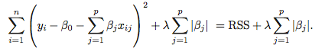
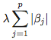
LASSO REGRESSION
Lasso Regression is similar to Ridge Regression, except we have the absolute value of beta in our penalty term,
the λ term is a tuning parameter. When it is zero we get least squares,
as it increases the term, (the shrinkage penalty) has more of an
impact and the coefficients will equal zero.

Slide 21
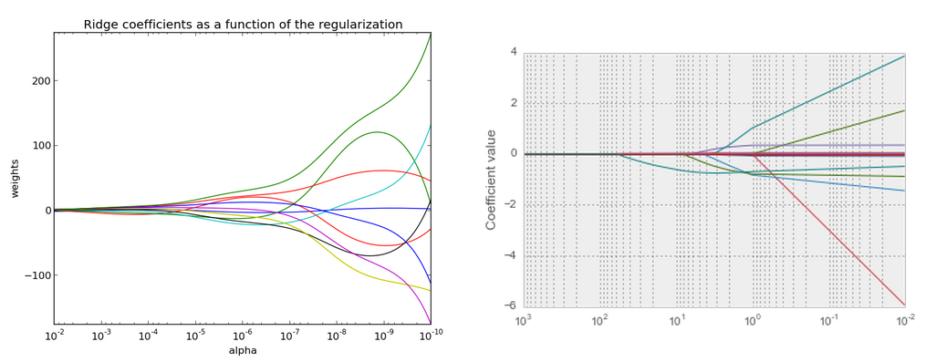
RIDGE VS LASSO

Slide 22
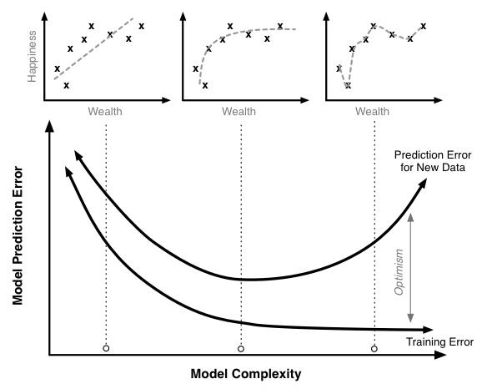
BIAS - VARIANCE TRADEOFF

Slide 23
Regularisation
Lasso Regularisation is useful if we believe many features are irrelevant, since a feature with a zero coefficient is essentially removed from the model. Thus, it is a useful technique for feature selection.

Slide 24

LAB 7a
DATA SCIENCE PART TIME COURSE

Slide 25
LAB 7b
DATA SCIENCE PART TIME COURSE

Slide 26
WEEK 4 - Review
DISCUSSION TIME
Logistic Regression
Test, Training and Validation data splits
Cross-Validation
Bias-Variance Trade-Off

Slide 27
Classification Homework
Hwk Challenge
Using the data in lesson-07/hwk: Predict the likelihood of rain
Load and clean the data
Create at least 1 additional feature for your model
Split your dataset into TRAIN (dev+test) sets 1950-2009
Use VALIDATION set as the data from 2010-2017
Create a model to predict whether any given day will see rain
Evaluate the success of your model with an appropriate metric
PDF your notebook and slack to Paul

Slide 28
PRE-READING
Read the following before next class
Clustering Methods in Introduction to Statistical Learning, Chapter 10.3 (15 pages)
OR
PCA: https://youtu.be/Zbr5hyJNGCs, https://www.youtube.com/watch?v=cnCzY5M3txk
Clustering: https://youtu.be/9991JlKnFmk
Python Notebook on Clustering http://nbviewer.ipython.org/github/nborwankar/LearnDataScience/blob/master/notebooks/D1.%20K-Means%20Clustering%20-%20Overview.ipynb
DATA SCIENCE – Next lesson

